Slide 1

MONTHLY PERFORMANCE REPORT
Melbourne Osteopathy Sports Injury Centre
March + April 2026

Slide 2

01 · OVERVIEW
Executive summary
April strong — YoY down 5.4% on a softer March
1,598 appointments held across Mar + Apr (vs 1,689 prior year, −5.4% YoY). March came in at 727, recovering from the Jan–Feb trough. April rebounded to 871 — the highest month in the trailing 12-month window.
New-patient growth outpacing flat traffic
95 new patients this period vs 89 last year (+6.7% YoY). AUS website visitors essentially flat: 2,579 (+0.2% YoY). Organic search averaging 776 sessions/month — SEO holding consistent. Visitor-to-new-patient conversion is improving.
Booking funnel converting at 12.8% — room to improve
742 people entered the Cliniko booking page across Mar + Apr (AUS, GA4 Key Events). 95 became new patients — a 12.8% booking-page-to-new-patient rate. The visit-to-booking-page rate is 28.8% (742 of 2,579 AUS visitors). Both steps have meaningful room to improve.
MOSIC · Mar + Apr 2026 · 02

Slide 3
02 · SNAPSHOT
Period snapshot — Mar + Apr 2026
Year-on-year comparison vs Mar + Apr 2025
WEBSITE VISITORS (AUS)
APPOINTMENTS HELD
TOTAL NEW PATIENTS
TOTAL NEW PATIENTS - GOOGLE
2,579
1,598
95
170
▲ 0.2% YoY
▼ 5.4% YoY
▲ 6.7% YoY
▲ 6.3% YoY
vs 2,574 prior year
vs 1,689 prior year
vs 89 prior year
vs 160 prior year
MOSIC · Mar + Apr 2026 · 03

Slide 4
03 · CLINIKO
Cliniko — appointments held
Source: Cliniko API. Original deck tracked 'Cliniko booking page confirmations' (GA4 event), which is a subset — this view shows all completed appointments.
MOSIC · Mar + Apr 2026 · 04

Slide 5


04 · GOOGLE ADS
Google Ads — phone calls
March
April
MOSIC · Mar + Apr 2026 · 06

Slide 6
05 · WEBSITE
Website traffic (AUS only)
Last 12 months — Mar + Apr 2026 highlighted in orange.
MOSIC · Mar + Apr 2026 · 07

Slide 7
06 · CONTENT
Most viewed pages — Mar + Apr 2026
Page | Views | Active users
/ | 1,131 | 712
/bookings | 669 | 369
/book-an-appointment-melb-osteo/ | 581 | 454
/book-an-appointment-pain-relief/ | 272 | 239
/team/ | 195 | 152
/bookings/confirmation | 179 | 107
/blog/osteopathy/osteopath_vs_chiropractor/ | 164 | 143
/essendon-osteopathy/ | 134 | 101
/our-services-osteopathy/ | 121 | 101
/about-us/ | 113 | 94
/team/dr-brendan-oloughlin/ | 101 | 76
/contact-us/ | 94 | 77
/team/dr-david-sokoloff/ | 83 | 63
/team/dr-shane-buntman/ | 78 | 53
/blog/training/what-is-the-posterior-chain/ | 69 | 65
/blog/health-well-being/why-does-my-back-hurt-while-washing-the-dishes/ | 63 | 58
/blog/osteopathy/is-sitting-cross-legged-causing-you-pain/ | 56 | 31
/team/dr-jessica-fetterplace/ | 51 | 40
/services/podiatry/ | 49 | 29
/about-us/who-we-are/ | 46 | 46
Top 20 pages by total views, Mar + Apr 2026. Source: GA4 (Australia only).
MOSIC · Mar + Apr 2026 · 08

Slide 8
07 · NEW BOOKINGS
Total new patients
Source: Cliniko API (patients created in window).
MOSIC · Mar + Apr 2026 · 09

Slide 9
07b · LOCATIONS
Appointments by location
MOSIC · Mar + Apr 2026 · 10

Slide 10
08 · AUTOMATIONS
Cliniqapps email automations
DNA Rebooker All Patients
Month | Patients Booked | Appointments Booked
April | 0 | 0
March | 6 | 25
February | 3 | 4
January | 6 | 10
Reactivation 6 – 12 Months
Month | Patients Booked | Appointments Booked
April | 4 | 7
March | 8 | 13
February | 3 | 4
January | 3 | 3
Cancellation Rebooker All Patient
Month | Patients Booked | Appointments Booked
April | 15 | 29
March | 11 | 28
February | 10 | 20
January | 12 | 24
Reactivation 12 Months +
Month | Patients Booked | Appointments Booked
April | 2 | 3
March | 1 | 2
February | 2 | 4
January | 2 | 6
Reactivation 3 – 6 Months
Month | Patients Booked | Appointments Booked
April | 7 | 8
March | 12 | 26
February | 5 | 6
January | 10 | 14
MOSIC · Mar + Apr 2026 · 12

Slide 11
09 · BROADCAST
Cliniqapps Newsletter Stats
Month | With or without appointments | Number of sends | Open Rate | Click Rate
April | With | 4561 | 32.56% | 0.55%
 | Without | 2989 | 18.87% | 0.54%
March | With | 4559 | 33.58% | 0.83%
 | Without | 3003 | 19.41% | 0.67%
February | N/A | - | - | -
January | N/A | - | - | -
December (End of year email) | With | 4475 | 33.97% | 0.83%
 | Without | 3004 | 21.47% | 1.53%
November | With | - | - | -
 | Without | - | - | -
October | With | 4456 | 36.94% | 0.79%
 | Without | 3023 | 23.55% | 0.63%
September | With | 4467 | 34.21% | 0.76%
 | Without | 3044 | 22.37% | 0.66%
August | With | 4452 | 44.41% | 0.58%
 | Without | 3067 | 27.19% | 0.39%
July | With | 4435 | 36.78% | 0.72%
 | Without | 3084 | 23.09% | 0.49%
June | With | - | - | -
 | Without | - | - | -
May | With | 4398 | 34.61% | 0.89%
 | Without | 3089 | 22.05% | 0.65%
April | With | 4411 | 40.81% | 0.79%
 | Without | 3107 | 24.72% | 0.39%
March | With | 4404 | 33.22% | 0.70%
MOSIC · Mar + Apr 2026 · 13

Slide 12
10 · ACTIONED
Actioned items this period
Website Development
Other
Uploaded – Managing Stress and Its Physical Impact on your body
Uploaded – Marathon Training Without Injury: Your complete Prevention Guide
Uploaded – Movement for Busy Lifestyles: Staying Active with Limited Time
Uploaded – Cardio vs Strength Training: Finding the Right Balance for Your Body
Uploaded – Running with a Cause: Train Smar for Melbourne’s Charity Runs
Added Rachel Limanou to the website
Updated Mo’s profile
Updated running injury webpage
Website team member order
Provided Q2 Marketing Calendar
Looked into the Moomba Magic
Looked into Linkedin Profile for MOSIC
Drafted the Internal database promotion
Revised the Google Ads
MOSIC · Mar + Apr 2026 · 14

Slide 13
10 · ACTIONED
Tasks for next two months
Website Development
Ongoing blog posting
Audit the 404 error websites
New scoliosis web page
TAC webpage
Other
Ongoing social media posting
Ongoing digital marketing support
Ongoing Google ads optimisation
MOSIC · Mar + Apr 2026 · 15

Slide 14
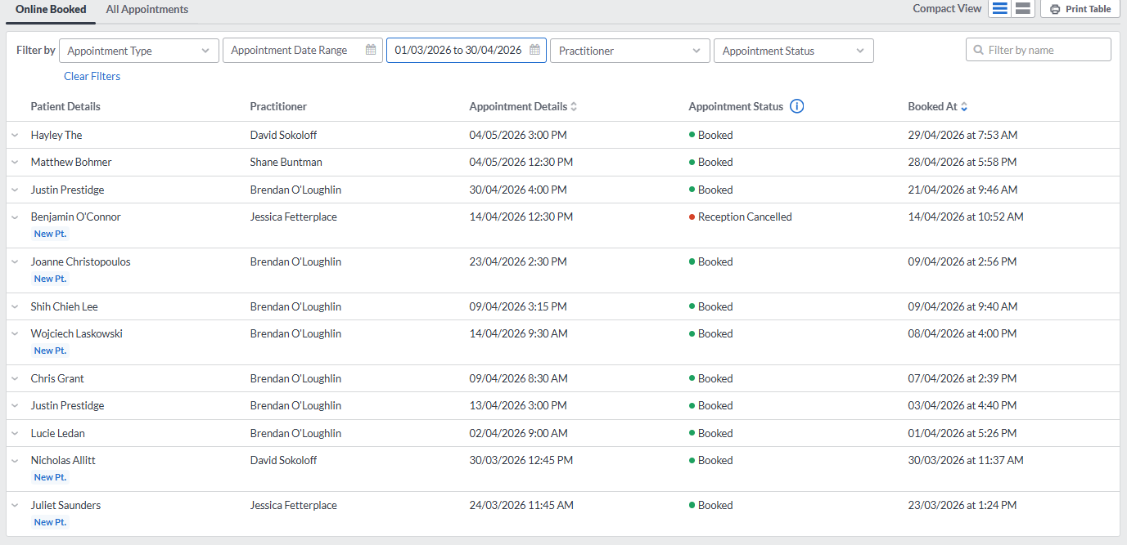
11 · APPENDIX
HotDoc bookings
MOSIC · Mar + Apr 2026 · 16

